Slide 1
ANU Governance
Belinda Farrelly
University Secretary
Director, Governance & Risk

Slide 2
WHAT IS GOVERNANCE?
Governance informs an organisation’s conduct, decision-making and practice. It supports an organisation to realise its ambition.
Good governance is built upon four key principles:
accountability, transparency, fairness and responsibility.
It is a framework that informs the rules, relationships, systems and processes around which authority is exercised and controlled and how those in control are held to account.
CORPORATE GOVERNANCE AND RISK OFFICE

Slide 3
ANU GOVERNING INSTRUMENTS
Australian National University Act 1991
(Note: New Bill has been drafted to replace ANU Act 1991 but remains under discussion)
Public Governance, Performance and Accountability Act 2013 (“PGPA Act”)
Higher Education Standards Framework (Threshold Standards) 2021
CORPORATE GOVERNANCE AND RISK OFFICE

Slide 4
ANU GOVERNING FRAMEWORK INFORMED BY:
Voluntary Code of Best Practice for the Governance of Australian Universities
(Approved by Ministerial Council for Tertiary Education and Employment, July 2021)
Corporate Governance Principles and Recommendations of the ASX Corporate Governance Council
(University benchmarks its governance arrangement against principles to extent they are applicable)
CORPORATE GOVERNANCE AND RISK OFFICE

Slide 5
GOVERNANCE STRUCTURE
COUNCIL STANDING COMMITTEES
COMMONWEALTH PARLIAMENT
FINANCE COMMITTEE
COVID-19 COMMITTEE
COUNCIL
AUDIT & RISK MANAGEMENT COMMITTEE
CAMPUS PLANNING COMMITTEE
VICE-CHANCELLOR AND PRESIDENT
REMUNERATION COMMITTEE
NOMINATION COMMITTEE
STUDENT SAFETY AND WELLBEING COMMITTEE
Deputy Vice- Chancellor (Academic)
Deputy Vice- Chancellor (Research & Innovation)
Deputy Vice- Chancellor (International and Corporate)
Vice-President (First Nations)
Vice-President (Advancement)
ACADEMIC BOARD
Pro Vice-Chancellor (Education & Digital)
Chief Financial Officer
CORPORATE GOVERNANCE AND RISK OFFICE

Slide 6
ROLE OF COUNCIL
The ANU Council ‘has the entire control and management of the University’ (s9 – ANU Act 1991)
Council is the governing and “accountable” authority
Council is to act in all manners in the way that best promotes the interest of the University
CORPORATE GOVERNANCE AND RISK OFFICE

Slide 7
COUNCIL DUTIES AS ACCOUNTABLE AUTHORITY
Duty to govern
Duty regarding risk and control
Duty to encourage cooperation
Duty in relation to requirements imposed on others
Duty to keep the responsible Minister and the Finance Minister informed
CORPORATE GOVERNANCE AND RISK OFFICE

Slide 8
ROLE AND RESPONSIBILITIES OF COUNCIL
Strategic oversight of the University including:
Setting the mission, values and strategic direction of the University; and
ongoing review of the success of those strategies
Ensuring effective overall governance and management of the University, including:
appointing the Chancellor and Pro-Chancellor;
appointing the Vice-Chancellor as principal academic and chief executive officer of the University, and monitoring performance;
overseeing and reviewing the management of the University and its performance;
ensuring that the strategic goals set by the Council are delivered;
overseeing and monitoring the academic activities of the University;
establishing policy and procedural principles, consistent with legal requirements and community expectations.
CORPORATE GOVERNANCE AND RISK OFFICE

Slide 9
ROLE AND RESPONSIBILITIES OF COUNCIL
Ensuring responsible financial and risk management of the University, including:
approving the annual budget, business plan and annual report;
overseeing and monitoring the assessment and management of risk across the University, including in its commercial undertakings;
approving and monitoring systems of control and accountability for the University and any entities controlled by the University (within the meaning of section 50AA of the Corporations Act 2001);
approving significant commercial activities of the University.
CORPORATE GOVERNANCE AND RISK OFFICE

Slide 10
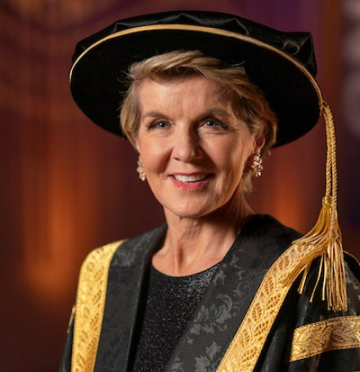
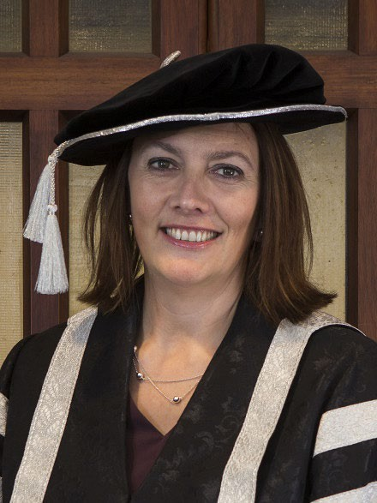
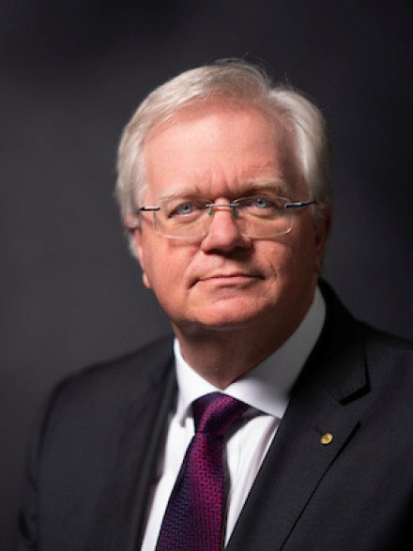
15 COUNCIL MEMBERS
Chancellor (Chair) – up to 4 years
Vice-Chancellor – term of appointment
7 members appointed by Minister – up to 4 years
3 members from ANU Academic staff – 2 years
1 Member from Professional Staff – 2 years
2 students (PG and UG) – 1 year
Chair, Academic Board (non voting member)
CORPORATE GOVERNANCE AND RISK OFFICE

Slide 11
HOW DOES COUNCIL OPERATE?
Chair (Chancellor) facilitates the meeting, discussion, resolutions.
Council rarely ‘votes’ – it takes decisions collectively.
ANU Executive attend Council to advise on matters and attend as observers, but speak only when invited.
Guests/staff are invited to present specific items.
Majority of meeting discussion (approx. 70%) is spent on Key Business / Strategic Items (Parts 2 and 3).
Council meets at least six (6) times per year.
CORPORATE GOVERNANCE AND RISK OFFICE

Slide 12
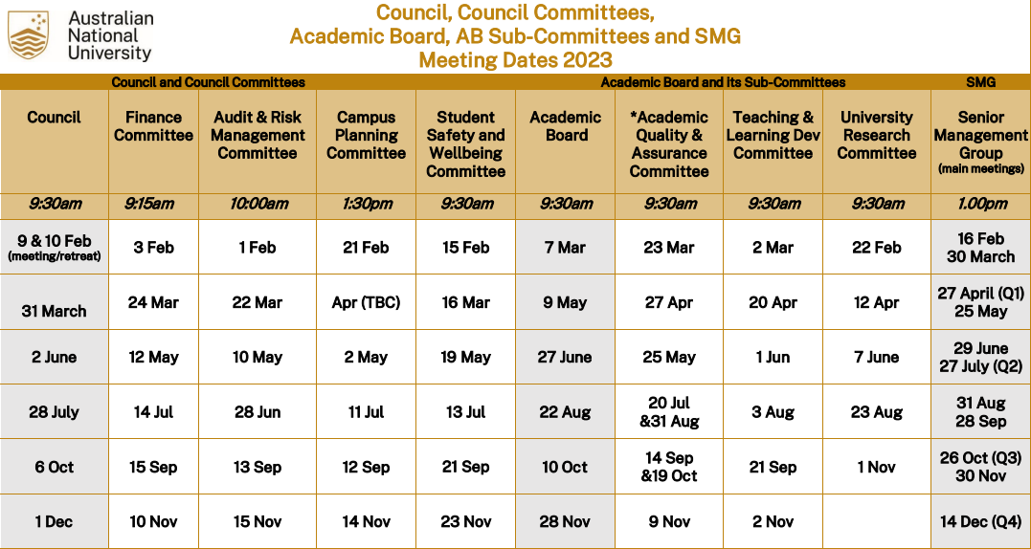
CORPORATE GOVERNANCE AND RISK OFFICE

Slide 13
PLANNING FOR ONE COUNCIL PAPER E.g. ANU Budget 2024
Budget design & preparation
Finance Committee
15 Sept 2023
Council
6 Oct 2023
Business area development
Finance Committee
15 Nov 202
Council
1 Dec 2023
Business area implementation
CORPORATE GOVERNANCE AND RISK OFFICE

Slide 14
LEGAL DUTIES AND WHY GOVERNANCE MATTERS TO YOUR ROLE
Included in the governing instruments of University is the Public Governance, Performance and Accountability Act 2013 (“PGPA Act”)
Under (s25 to 29) of the PGPA Act, an official of the University must:
Exercise care and diligence
Act in good faith and for proper purpose
Use position & information properly
Disclose material personal interests
As an ANU employee, you are considered an official as referenced in the PGPA Act
CORPORATE GOVERNANCE AND RISK OFFICE

Slide 15
TRAINING OPPORTUNITIES
Governance Essentials
https://services.anu.edu.au/training/training-workshop-anu-governance-essentials
Policy Training Workshops Program
https://services.anu.edu.au/training/policy-training-workshops-program
The program consists of three workshops:
Introduction to policy governance
Effective policy development and review
Communications and consultation for policy work
Unearthing Policies, Delegations and Disclosures of Interest
https://services.anu.edu.au/training/training-workshop-unearthing-policies-delegations-disclosures-of-interest
Being a Committee Secretary
https://services.anu.edu.au/training/being-a-committee-secretary
CORPORATE GOVERNANCE AND RISK OFFICE

Slide 16
QUESTIONS?
CORPORATE GOVERNANCE AND RISK OFFICE

Slide 17
HELPFUL LINKS
Australian National University Act 1991
https://www.legislation.gov.au/Series/C2004A04206
Higher Education Standards Framework 2021 (HESF)
https://www.legislation.gov.au/Details/F2022C00105
ANU (Governance) Statute 2023
https://www.legislation.gov.au/Details/F2023L00867
CORPORATE GOVERNANCE AND RISK OFFICE

Slide 18
HELPFUL LINKS
ANU Council Charter (amended and approved 10 February 2022)
https://www.anu.edu.au/files/committee/Council%20Charter_0.pdf
Standing Orders of the ANU Council and Council Committees
https://www.anu.edu.au/files/committee/Standing%20Orders%20of%20the%20ANU%20Council%20and%20Council%20Committees.pdf
ANU Finance Committee (Main page)
https://www.anu.edu.au/about/governance/committees/finance-committee
ANU Finance Committee Charter
https://www.anu.edu.au/files/committee/Charter%20-%20Finance%20Committee%20-%20Approved%20by%20Council%2010%20February%202022.pdf
CORPORATE GOVERNANCE AND RISK OFFICE

Slide 19
CORPORATE GOVERNANCE & RISK OFFICE – WHAT WE DO…
Council
Council Committees
Academic Board & sub committees
Policy
Internal Audits
Delegations
Strategic Risk
ANU Legislation
Fraud control
CORPORATE GOVERNANCE AND RISK OFFICE

Slide 20
CONTACT US:
https://services.anu.edu.au/business-units/corporate-governance-risk-office
Belinda Farrelly
University Secretary
Director, Governance and Risk
E: belinda.Farrelly@anu.edu.au
E: director.governance@anu.edu.au

