Slide 1
ANU Learning and Teaching
Updates June 2023
SIS Divisional Staff meeting
Professor Maryanne Dever, PVC (Education & Digital)

Slide 2
From the Academic Portfolio
Quick updates and 2023 activities
Key staff
What’s happening strategy-wise in Learning and Teaching?
Digital Uplift: where are we at in Learning and Teaching?

Slide 3
What’s New? Quick updates
TLDC Charter changes, including name change to Learning and Teaching Committee (subject to AB approval)
ANU Careers name change to
ANU Careers and Employability
New Careers and Employability home in Haydon Allen

Slide 4
What else is happening in 2023?
Roll out of Curriculum Framework and Graduate Attributes
Initial programs of work starting for Learning and Teaching Strategy
Strategic Learning and Teaching Grants being offered ($1 million + available)
Procurement work underway for Learning Ecosystem (Student First), including digital assessment platform and solutions for internships and Career Hub
Employability Framework in development
New service models for Careers and for the Centre for Learning and Teaching
Creation of resources to support the return to on-campus learning in semester 2 2023, including a video to share.

Slide 5
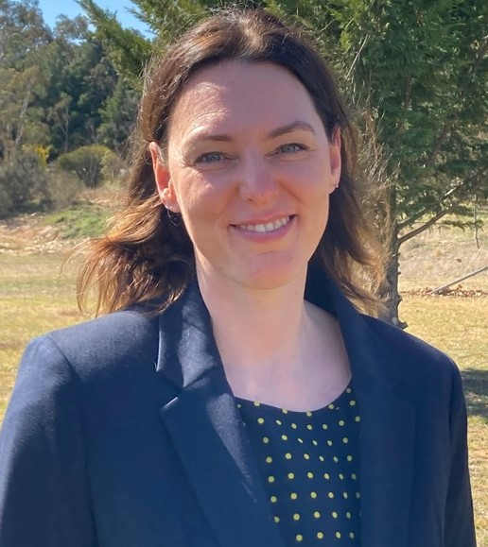
Key personnel
Lucy Arthur
Director, Centre for Learning & Teaching
Elizabeth Bailey
Manager, ANU Careers
Susanne Jones
NPILF / Employability Framework

Slide 7
Why renewal now?
We need to work together to close the gap between our current state and that envisioned in the ANU 2021 - 2025 Strategic Plan.
Academic and professional staff who have worked to support ANU through the COVID period are in a different place:
They have new clarity on the University’s expectations for quality learning and teaching
Many are now open to reimagining how learning will be delivered in future.
As a result of the COVID years, our students have experienced both disruptions and new possibilities. They have ideas about what they want their learning to look like in the years ahead. Think flexibility.
We have funding committed in principle under the DMP for significant digital uplift.
“The pandemic has … challenged all in the education sector to redefine what learning and teaching should look like”.
Camille Dickson-Deane in the 2022 EDUCAUSE Horizon Report -Teaching and Learning Edition

Slide 8
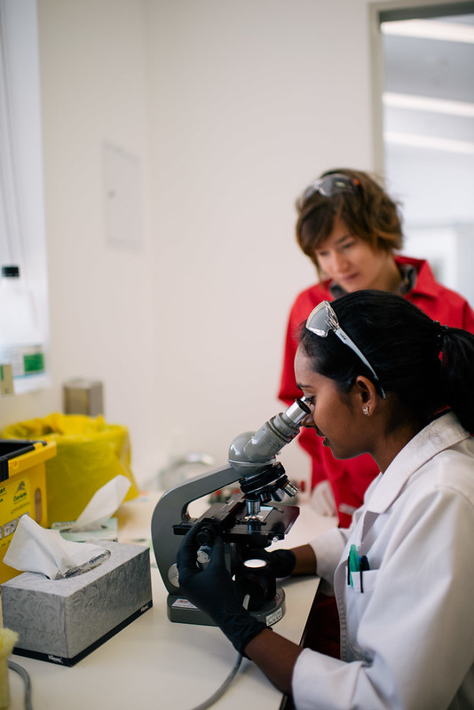
Our framework for educational renewal
ANU Curriculum Framework and ANU Graduate Attributes. Approved by Academic Board in 2022.
ANU Learning and Teaching Strategy. Approved by Academic Board in 2022.
Student First: Part of the ANU Digital Master Plan. Approved by SMG and Council in 2021.

Slide 9
Strategy into practice
We are undertaking an integrated program of work with College partners.
The Curriculum Framework (incorporating our Graduate Attributes) will provide the ‘what’ to the ‘how’ of the Learning and Teaching Strategy.
The timing of the Student First program means that as we do the important work of reimagining our curriculum and how we deliver learning, we can have direct input into the design of the digital foundations that support those plans.

Slide 10
Staff want
Better use of their time
Joined up systems that work
Manual work-arounds gone
Quality and innovation without pain and stress
Students want
Better use of their time
Joined up systems that work
Quality and consistency in their learning experiences
Well-organised learning experiences
Meaningful feedback
A genuine sense of belonging in our classrooms whether in-person or online
Flexibility

Slide 11
Learning is transforming
Current state | Future state
Considerable dependence on lectures and more passive forms of learning | More active and engaged learning; flipped options.
High use of exams and essays for assessments; low student satisfaction with feedback | More alternatives to exams, greater use of authentic assessment, focus on broadening skills; intentionally designed online assessment delivered via a new integrated platform; feedback that works
Online course sites are mostly static repositories | Online course sites are dynamic and offer high levels of interaction and active learning opportunities
F2F and on-campus predominantly | Move away from F2F/online distinction to ‘learning’. More flexibility; flipped learning options. Maybe fully online electives, online and hybrid postgrad offerings.
Fragmented and uneven online experience, array of supported and unsupported tools | Seamless digital learning environment; streamlined environment

Slide 12
Strategic Learning and Teaching Grants
The Strategic Learning and Teaching Grants created to accelerate work on our strategic initiatives in Education.
Funding is made available through the National Priorities and Industry Linkage Fund (NPILF).
Grant funding will be made available in two phases. Approximately $500K of funding will be available in the first phase (second half of 2023) with a second phase of approximately $500K to be made available in 2024.
Opening 3 July and closing 1 September 2023.

Slide 13
Strategic Learning and Teaching Grants
The NPILF program of funding and pilot launched in 2021 by the federal government was designed to produce job-ready graduates by encouraging innovation and enhancing engagement with industry.
Specifically, the three main objectives of NPILF are to:
Increase the number of internships, practicums, and other innovative approaches to work-integrated learning
Increase the number of STEM-skilled graduates and improve their employment outcomes
Support universities to develop and strengthen partnership and collaborations with industry.
The NPILF objectives are closely aligned with work underway through the ANU Strategic Initiatives in Education and the overall program of educational renewal.

Slide 14
Grant priorities
Authentic learning /or authentic assessment
Industry engagement in learning and teaching, including industry advisory boards
Development and embedding of professional and career literacy
Work-integrated learning opportunities and enhancements
Embedding of ANU Graduate Attributes in learning and teaching
Innovative approaches to First Year pedagogy and holistic First Year course redesign
Forms of active and experiential learning
Cross-School and cross-College collaboration on transdisciplinary learning, including:
STEM + non-STEM collaboration.
STEM skills development in non-STEM courses and programs
Systematic mapping and embedding of research skills at the discipline and program level
Progressive development of digital literacies across disciplines and/or programs

Slide 15
We are encouraging applicants to talk to:
Colleagues in other schools and colleges
Centre for Learning and Teaching
ANU Careers and Employability
ANU Libraries
Think partnership, collaboration, and impact

Slide 16
Student First: New learning ecosystem
Procurement work underway for a new Learning Ecosystem, including digital assessment platform and solutions for internships and Career Hub
The core is a new learning management system (LMS) to replace Wattle.
Business case is being finalised; will proceed to committees in July/August
The Tender Evaluation Committee is currently being finalised; includes College representation
Principles governing the design for course sites in the new LMS will be reviewed and endorsed by the Learning and Teaching Committee (formerly TLDC)
Communication and change plans will accompany the roll out to smooth the transition

Slide 17
What staff and students want from digital uplift
From a review of ANU Student First research conducted to date, six key themes identified as relevant to Learning and Teaching Ecosystems:​
Staff want a good support model​
Staff want to use systems so we work efficiently​
Students want a consistent course site structure within a flexible & safe user experience​
Staff want to deliver innovative and inclusive learning experiences within a stable and secure environment​
Staff want improved digital solutions for assessment​
Staff want to be able to report & measure

Slide 18
The ANU Employability Framework
What is it?
Provides a clear definition of how we as a University understand and approach student employability
Maps how we support our students in developing the competencies and attributes that enable them to graduate as confident, connected, global citizens
Guides how we will embed professional literacy throughout the curriculum
Guides how we will engage with industry and employers within our programs of study and co-curricula activities
Ensures our programs of study maintain currency and relevance for the changing nature of work and employment
Articulates guiding principles that connect employability to our strategic vision and initiatives
Creates consistent experiences for students across the university
The framework is being developed across 2023.
Terms of reference for a working group have been endorsed by TLDC.

Slide 19
Thank you

