Slide 1
SIS Meeting
Key: 236663
Mike MacKenzie Artificial Intelligence & AI & Machine Learning http://www.vpnsrus.com
)
Notes:
https://www.flickr.com/photos/152824664@N07/30212411048/

Slide 2
Welcome
.
Yumma
1.1 Reports
University Librarian
Associate Director Libraries University Archivist
2. Speakers
10.30 Pro Vice-Chancellor (Education & Digital) Maryanne Dever on developments in Learning and teaching
11.00 James Brann, Director, University Experience on Initiatives Including student safety
ANU Scholarly information services

Slide 3
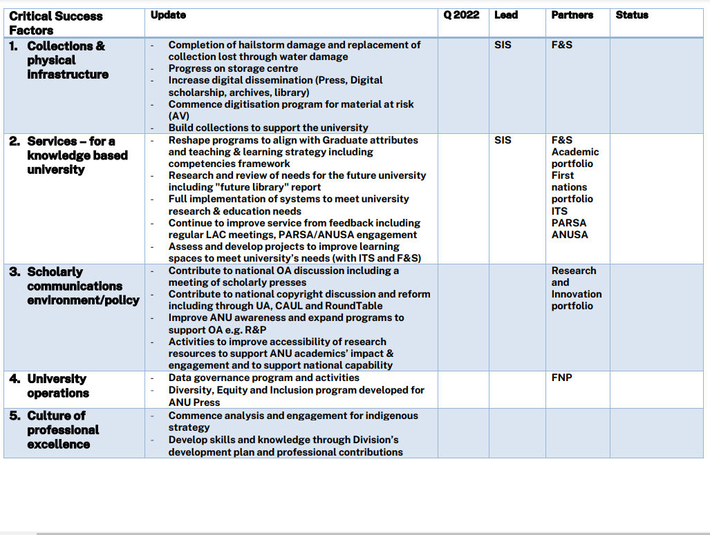
SIS Plan
.
https://services.anu.edu.au/files/review/SIS-Plan-2023.pdf
ANU Scholarly information services
Notes:
Wave Hill Station is located approximately 600km south of Darwin in the Victoria River District of the Northern Territory. Wave Hill Station was established in 1883. Vesteys, a British pastoral company owned the cattle station since 1914 and ran the station through its subsidiary the Wave Hill Pastoral Co Ltd. In 1954 Vesteys took out the first pastoral development lease for its Wave Hill property. The station is most famous for being home of the ’Wave Hill Walk-off’ in 1966, when Vincent Lingiari, a Gurindji spokesman, led a walk-off of 200 Aboriginal stockmen, house servants, and their families from Wave Hill as a protest against work and pay conditions.

Slide 4
University developments
.
PARSA
Reconciliation week events and resources
Students First
Digital students experience – CRM
Learning ecosystem – integrated suite of learning management systems
ANU Scholarly information services
Notes:
http://read.alia.org.au/united-nations

Slide 5
Workforce plan
.
ANU Scholarly information services
Notes:
Wave Hill Station is located approximately 600km south of Darwin in the Victoria River District of the Northern Territory. Wave Hill Station was established in 1883. Vesteys, a British pastoral company owned the cattle station since 1914 and ran the station through its subsidiary the Wave Hill Pastoral Co Ltd. In 1954 Vesteys took out the first pastoral development lease for its Wave Hill property. The station is most famous for being home of the ’Wave Hill Walk-off’ in 1966, when Vincent Lingiari, a Gurindji spokesman, led a walk-off of 200 Aboriginal stockmen, house servants, and their families from Wave Hill as a protest against work and pay conditions.

Slide 6
Workforce plan
.
ANU Scholarly information services
Notes:
Wave Hill Station is located approximately 600km south of Darwin in the Victoria River District of the Northern Territory. Wave Hill Station was established in 1883. Vesteys, a British pastoral company owned the cattle station since 1914 and ran the station through its subsidiary the Wave Hill Pastoral Co Ltd. In 1954 Vesteys took out the first pastoral development lease for its Wave Hill property. The station is most famous for being home of the ’Wave Hill Walk-off’ in 1966, when Vincent Lingiari, a Gurindji spokesman, led a walk-off of 200 Aboriginal stockmen, house servants, and their families from Wave Hill as a protest against work and pay conditions.

Slide 7
Post COVID university needs and future planning
.
ANU Scholarly information services
Notes:
Wave Hill Station is located approximately 600km south of Darwin in the Victoria River District of the Northern Territory. Wave Hill Station was established in 1883. Vesteys, a British pastoral company owned the cattle station since 1914 and ran the station through its subsidiary the Wave Hill Pastoral Co Ltd. In 1954 Vesteys took out the first pastoral development lease for its Wave Hill property. The station is most famous for being home of the ’Wave Hill Walk-off’ in 1966, when Vincent Lingiari, a Gurindji spokesman, led a walk-off of 200 Aboriginal stockmen, house servants, and their families from Wave Hill as a protest against work and pay conditions.

Slide 8
WHS
.
ANU Scholarly information services
Notes:
Wave Hill Station is located approximately 600km south of Darwin in the Victoria River District of the Northern Territory. Wave Hill Station was established in 1883. Vesteys, a British pastoral company owned the cattle station since 1914 and ran the station through its subsidiary the Wave Hill Pastoral Co Ltd. In 1954 Vesteys took out the first pastoral development lease for its Wave Hill property. The station is most famous for being home of the ’Wave Hill Walk-off’ in 1966, when Vincent Lingiari, a Gurindji spokesman, led a walk-off of 200 Aboriginal stockmen, house servants, and their families from Wave Hill as a protest against work and pay conditions.

Slide 9
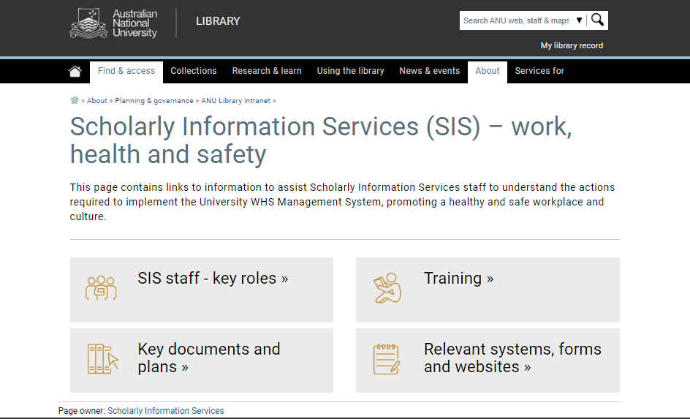
WHS
.
ANU Scholarly information services
Notes:
Wave Hill Station is located approximately 600km south of Darwin in the Victoria River District of the Northern Territory. Wave Hill Station was established in 1883. Vesteys, a British pastoral company owned the cattle station since 1914 and ran the station through its subsidiary the Wave Hill Pastoral Co Ltd. In 1954 Vesteys took out the first pastoral development lease for its Wave Hill property. The station is most famous for being home of the ’Wave Hill Walk-off’ in 1966, when Vincent Lingiari, a Gurindji spokesman, led a walk-off of 200 Aboriginal stockmen, house servants, and their families from Wave Hill as a protest against work and pay conditions.

